Slide 1
Welcome and Scene Setting
2nd W3C WoT Workshop, Munich, Germany, 4/5 June 2019

Slide 2
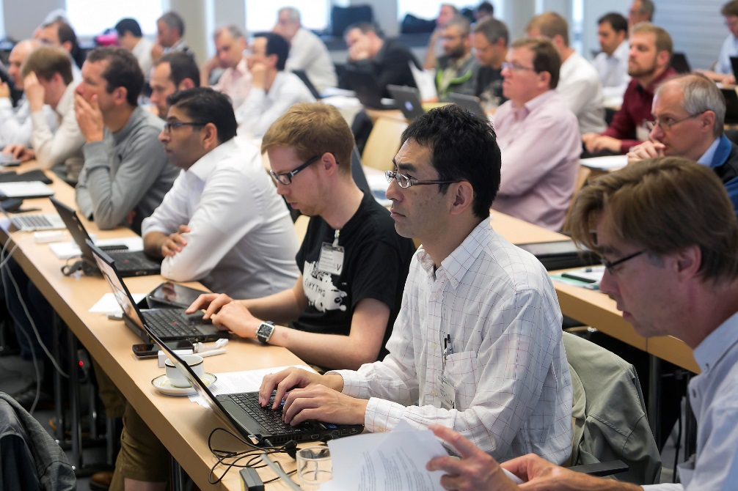
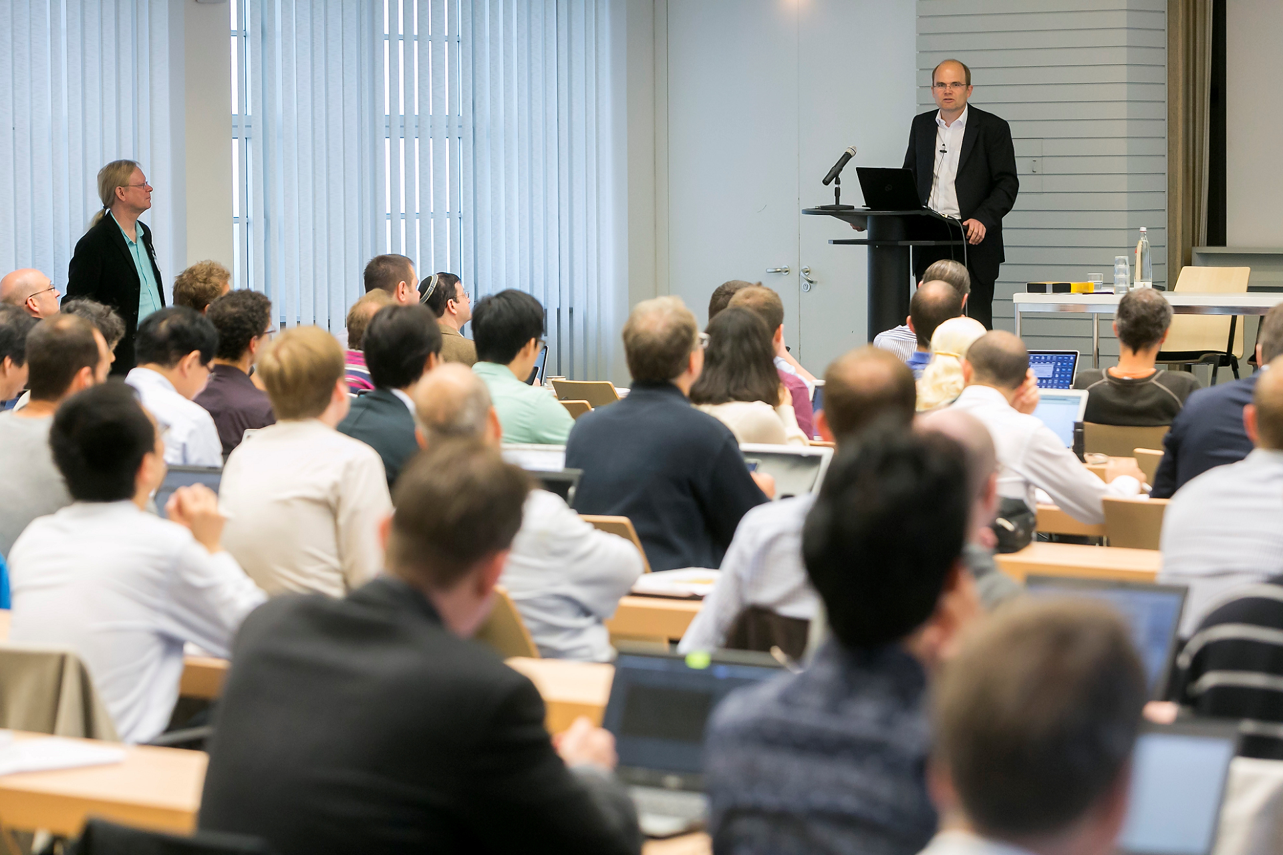
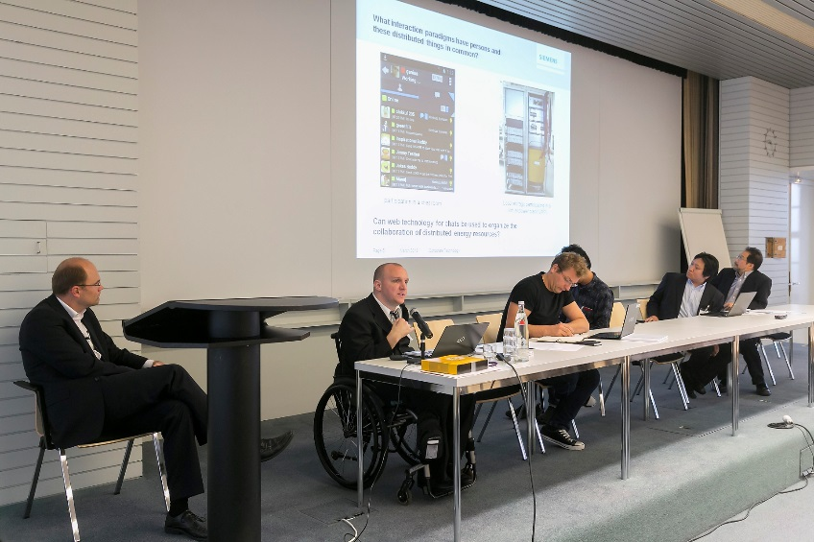
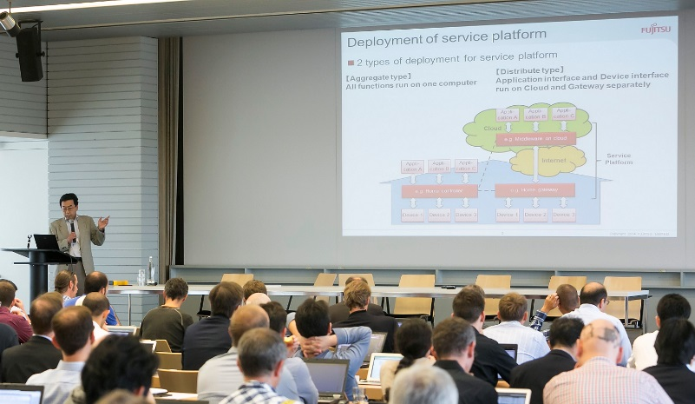
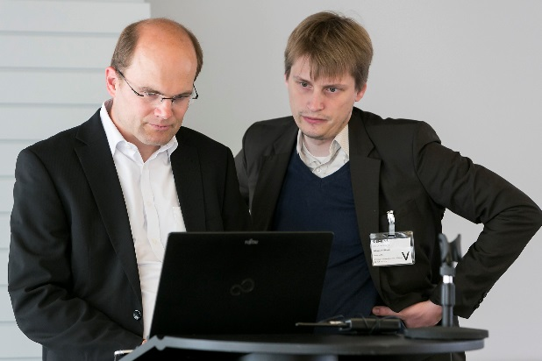
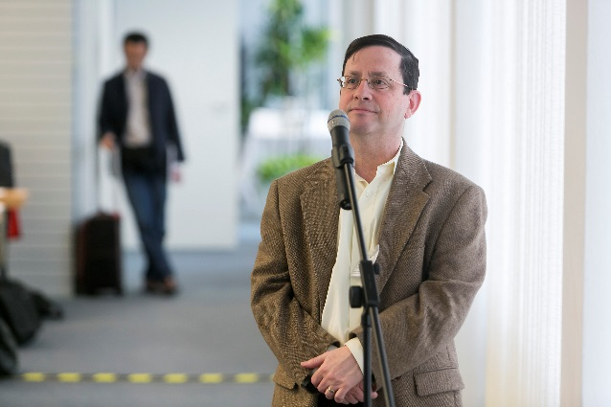
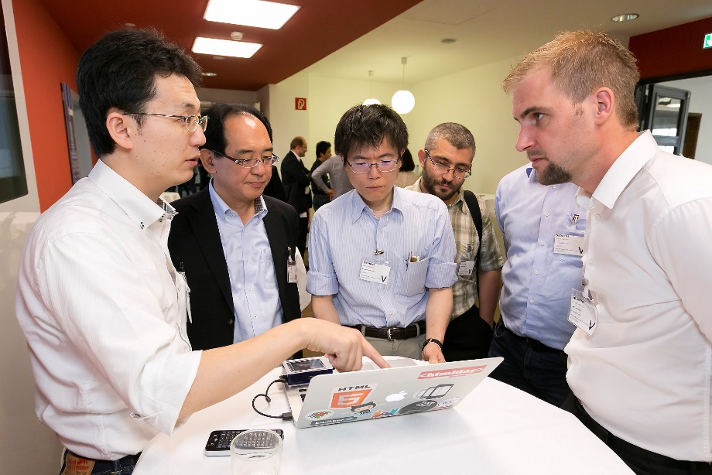
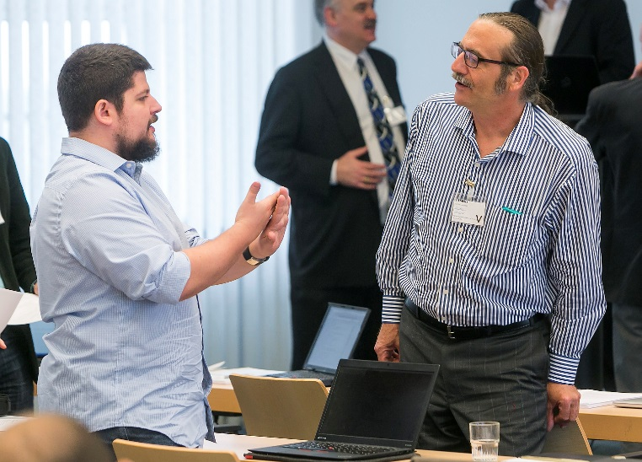
Remember?

Slide 3
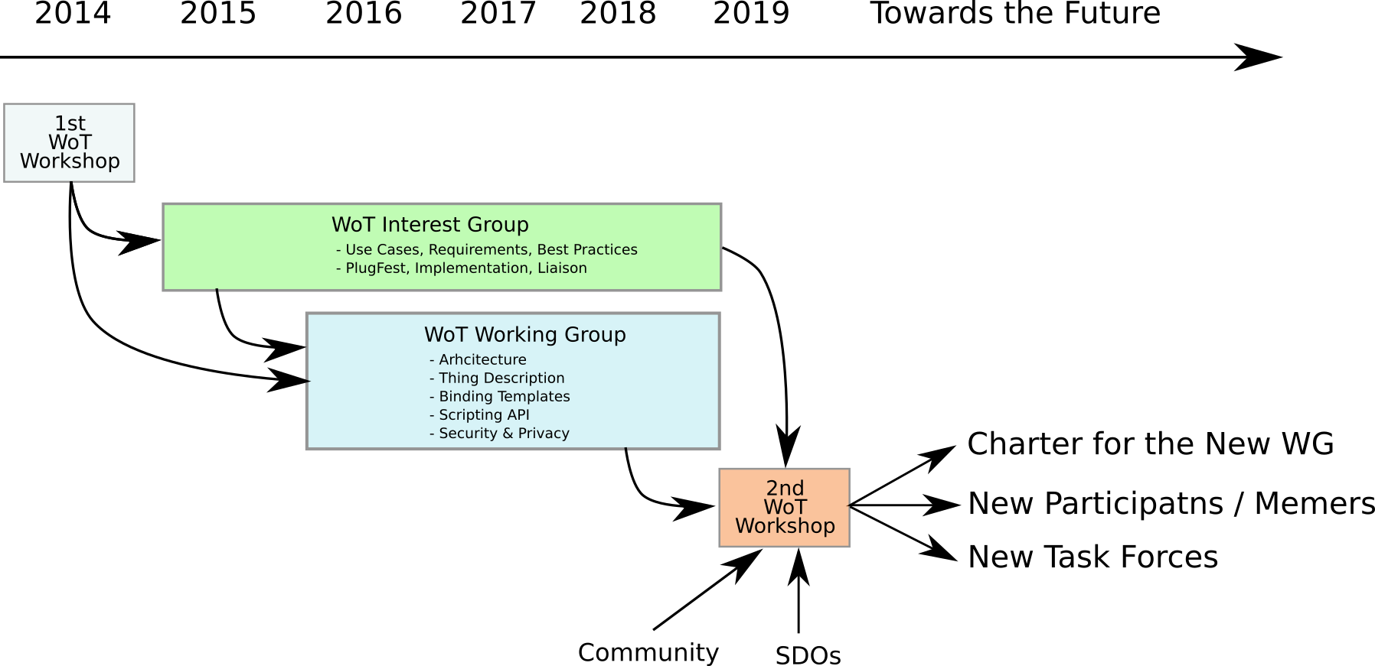
Timeline and Expectations

Slide 4
Statistics
 | OpenDay | Workshop Day 1 / 2
Participants | 140 | 61
Organizations | 60 | 46
New Comers | 25 | 14

Slide 5
Logistics
We should have all session presentations before the session starts
Send your presentation to Sebastian.Kaebisch@siemens.com and Michael.Lagally@oracle.com
Length of your talks:
Lightning talk: 10 minutes, incl. Q&A
Full talk: 30 minutes, incl. Q&A
Wifi access
SSID: SWSGUEST01
http://3wi.fi
Click ‘Visitor registration’
Enter your name, mobile number, and Sebastian.Kaebisch@siemens.com as Siemens contact

Slide 6
Agenda Tuesday, June 4th
 | Session | Moderator
Morning 1 | Welcome and setting the Scene | Workshop Chairs Kazuyuki Ashimura (W3C)
 | Greetings from W3C CEO | Dr. Jeff Jaffe
 | Use Cases / Deployment | Michael Lagally (Oracle)
Coffee Break
Morning 2 | Tooling / Implementations | Michael Lagally (Oracle)
Lunch

Slide 7
<Agenda Tuesday, June 4th>
 | Session | Moderator
Afternoon 1 | Tooling and Implementation | Sebastian Käbisch (Siemens)
Coffee Break
Afternoon 2 | Security and Privacy | Michael McCool (Intel)
 | Wrapup | Michael Lagally (Oracle) + Sebastian Käbisch (Siemens)

Slide 8
<Agenda Wednesday, June 5th>
 | Session | Moderator
 | Keynote: The Singapore Experience Chinn Hwa Lim Government Technology Agency Singapore
Morning 1 | Extensions for WoT Standardisation, Semantics, Linked Data | Sebastian Käbisch (Siemens)
Coffee Break
Morning 2 | Extensions for WoT Standardisation, Semantics, Linked Data | Sebastian Käbisch (Siemens)
Lunch

Slide 9
<Agenda Wednesday, June 5th>
 | Session | Moderator
Afternoon 1 | Future Work, Collaboration with other SDOs | Michael Lagally (Oracle)
Coffee Break
Afternoon 2 | Future Work, Collaboration with other SDOs | Michael Lagally (Oracle)
 | Wrapup and Next Steps | Michael Lagally (Oracle) + Sebastian Käbisch (Siemens)
 | Closing remarks

Slide 10

Contact
Kazuyuki Ashimura
W3C Staff
Web of Things Team Contact
ashimura@w3.org
team-wot@w3.org

